Slide 1
Web Security 2
devgianlu • 15/05/2024

Slide 2
More server-side vulns
SQL injections
Logic flaws

Slide 3
Server side:
SQL injection

Slide 4
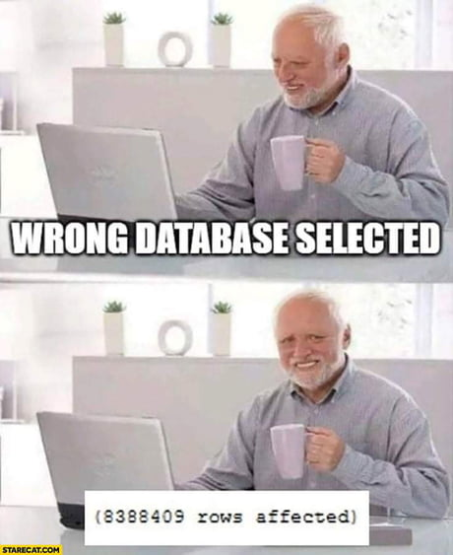
Why Structured Query Language
SQL is commonly used to interact with databases for storing information efficiently in web applications such as:
Login data (usernames and passwords)
Cookie tokens
User generated content (posts, comments, etc)
For this reason, its content should be guarded against attacks and backed up often: it is the heart of every web application.
BUT, it’s a very common mistake to mess up SQL queries because of laziness.
There are various “backends” that can be used as databases, but most of them behave equally so it doesn’t matter much to us.

Slide 5
SQL 101
CREATE TABLE “Users” (username VARCHAR(256) PRIMARY KEY, password VARCHAR(256));
SELECT password FROM “Users” WHERE username = “foo”;
INSERT INTO “Users” (username, password) VALUES (“foo”, “bar”);
DELETE FROM “Users” WHERE username = “foo”;
UPDATE “Users” SET password = “baz” WHERE username = “foo”;

Slide 6
Prepared Statements
All libraries in all languages for interacting with databases provide such called prepared statements which are queries that miss only the value part. For example:
INSERT INTO “Users” (username, password) VALUES ($1, $2)
This query doesn’t make sense until we specify what those $1 and $2 placeholders mean and that’s done by the library we use. This guarantees that the values are passed directly to the database and are inserted without being modified or reinterpreted.
Prepared statements are also more efficient than normal queries since they can be reused with different values. ORM (object-relational mapping) can also be used to avoid SQL injections and be efficient (kinda).
Not using prepared statements usually induces problems called SQL injections where user controlled input can be placed in the query and interpreted as SQL rather then a raw value.

Slide 7
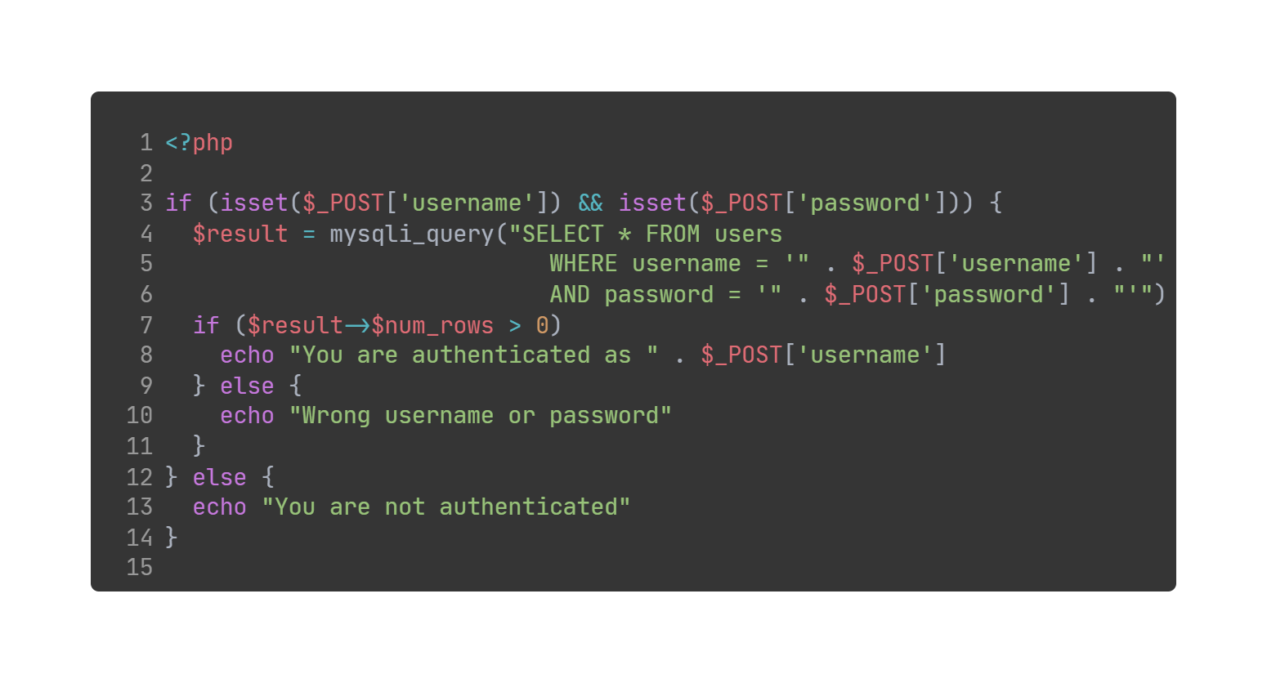
Login bypass
I told you to use prepared statements!
Source code

Slide 8
Stealing other data
What if we want to steal some data from the database? That is possible in multiple ways. If the output of the query is shown to the user we can use a so called union-based SQL injection.
Union-based SQL injections use the UNION keyword from SQL to “append” the columns of another table to the one we should be querying.
Consider the following query:
SELECT id, title, content FROM “Posts” WHERE id = <something>
If we control <something> entirely we can request any post, but what if we want to access another table? Have a look at this:
SELECT id, title, content FROM “Posts” WHERE id = 420
UNION SELECT 1, ‘’, secret FROM “Secrets”

Slide 9
Stealing other data, but blackbox
There’s a problem with our approach if we don’t know how the main query behaves:
SELECT * FROM “Posts” WHERE id = 420
UNION SELECT secret FROM “Secrets”
This query will raise an error and fail if the table Posts has more than one column. That’s because UNION queries must have the same number of columns in all the involved queries.
There’s two ways to discover the number of columns returned by the main query:
Bruteforce with UNION SELECT 1, 2, 3, …
Binary search with ORDER BY
The first one is suitable only for small tables but easier to implement while the second one is more powerful but takes a bit more effort.
To be sure no other parts of the query interfere with our injection we can add a comment after the injection: -- (two dashes and a space)

Slide 10
How many columns do you have?
The bruteforce approach is straightforward, just try doing a select with increasingly more arguments until it works:
… UNION SELECT 1 -> fail
… UNION SELECT 1,2 -> fail
… UNION SELECT 1,2,3 -> fail
… UNION SELECT 1,2,3,4 -> ok
The ORDER BY approach uses the fact that ordering can be specified with the index of the column in the table, the query will fail if the index is greater than the number of columns:
… ORDER BY 50 -> fail
… ORDER BY 25 -> fail
… ORDER BY 10 -> ok
… ORDER BY 15 -> ok
… ORDER BY 17 -> fail
… ORDER BY 16 -> ok
The table has 16 columns!

Slide 11
Bypassing limits
Often queries will have LIMIT clauses (or program logic) to avoid returning too many rows, for example a login form may limit the results to 1 or a posts page to 25 to avoid making the page too long. Since we are appending our table rows to the end, we may miss the rows we are interested in.
A simple enough bypass is to make the main query return 0 rows with a logic trick (supposing Posts has 4 columns):
SELECT * FROM “Posts” WHERE id = 420 AND 1=0
UNION SELECT 1, 2, 3, secret FROM “Secrets”
This way we are sure the main query will always return 0 rows since 1=0 is never true. Another approach might be to specify a parameter that we are sure doesn’t exist:
SELECT * FROM “Posts” WHERE id = 100000000
UNION SELECT 1, 2, 3, secret FROM “Secrets”

Slide 12
More blackbox
It might happen that we don’t know what to steal because we don’t know what’s on the database and what are the table names. Luckily all databases have tables containing this information, on MySQL they are all contained in the information_schema, other databases have similar ways.
SELECT schema_name FROM information_schema.schemata
SELECT table_name FROM information_schema.tables WHERE table_schema = DATABASE()
SELECT table_name, column_name FROM information_schema.columns WHERE table_schema = DATABASE()
These queries will return all scheme names, all table names in the current scheme and all column names for all tables in the current scheme.
These information allow us to potentially dump the entire database through a SQL injection.

Slide 13
Recap
Find SQL injection
Figure out how many columns the main query returns
Make the first query return 0 rows
Leak information about the database
Leak what you need
Tips:
group_concat can be used to concat rows if the main query returns too few columns
OFFSET can be used to leak more rows if the program logic limits the amount of rows shown

Slide 14
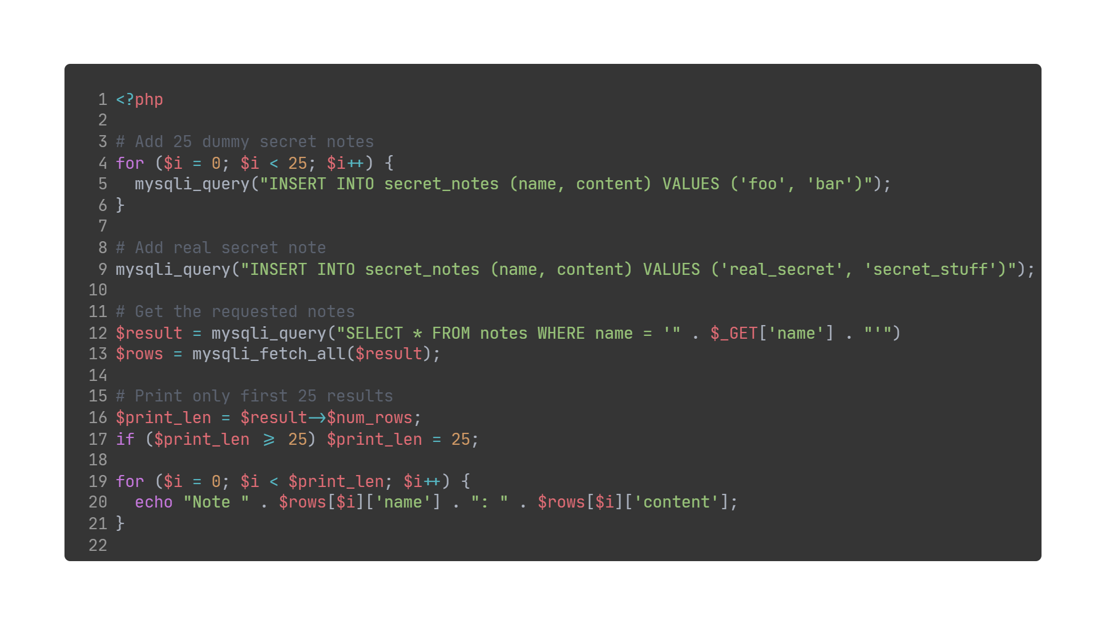
Can you read that far?
Source code

Slide 15
Blind SQLi
Obviously we don’t just have blind command injection, we also have blind SQL injection. That means we don’t have the data output of the SQL query, but we might have output in form of true/false (like the login form).
To exfiltrate data with this kind of vulnerability we’ll rely entirely on true/false results. A common pattern is:
SELECT * FROM “Posts” WHERE id = 1 AND (SELECT 1 WHERE <condition>) = 1
With this primitive we have full control over condition and can use whatever we want. The result is that the overall query will return something only if condition is true. If we are able to distinguish between when something is returned and something isn’t (login page, list of posts, etc) we’re good.
But if it’s not the case, we can use a time-based SQL. We can make the server wait before returning the response in the positive cases:
SELECT * FROM “Posts” WHERE id = 1 AND (SELECT sleep(1) WHERE <condition>) = 1

Slide 16
Blind SQLi (cont.)
We have our oracle, how do we use to read data? There are a couple of ways:
The SUBSTR function, it extracts a substring from a column
SELECT 1 FROM “Users” WHERE username = ‘foo’ AND SUBSTR(password, 4, 1) = ‘x’
The LIKE operator, checks whether the column value is “similar” to the provided one
SELECT 1 FROM “Users” WHERE username = ‘foo’ AND password LIKE ‘x%’
These two payloads can be used to exfiltrate the password of the user with username “foo” one character at a time.
The first one checks if the fourth character of the password is equal to x, the second one checks if the password starts with x. With both approaches a linear bruteforce is required which is a lot better than a standard bruteforce.

Slide 17
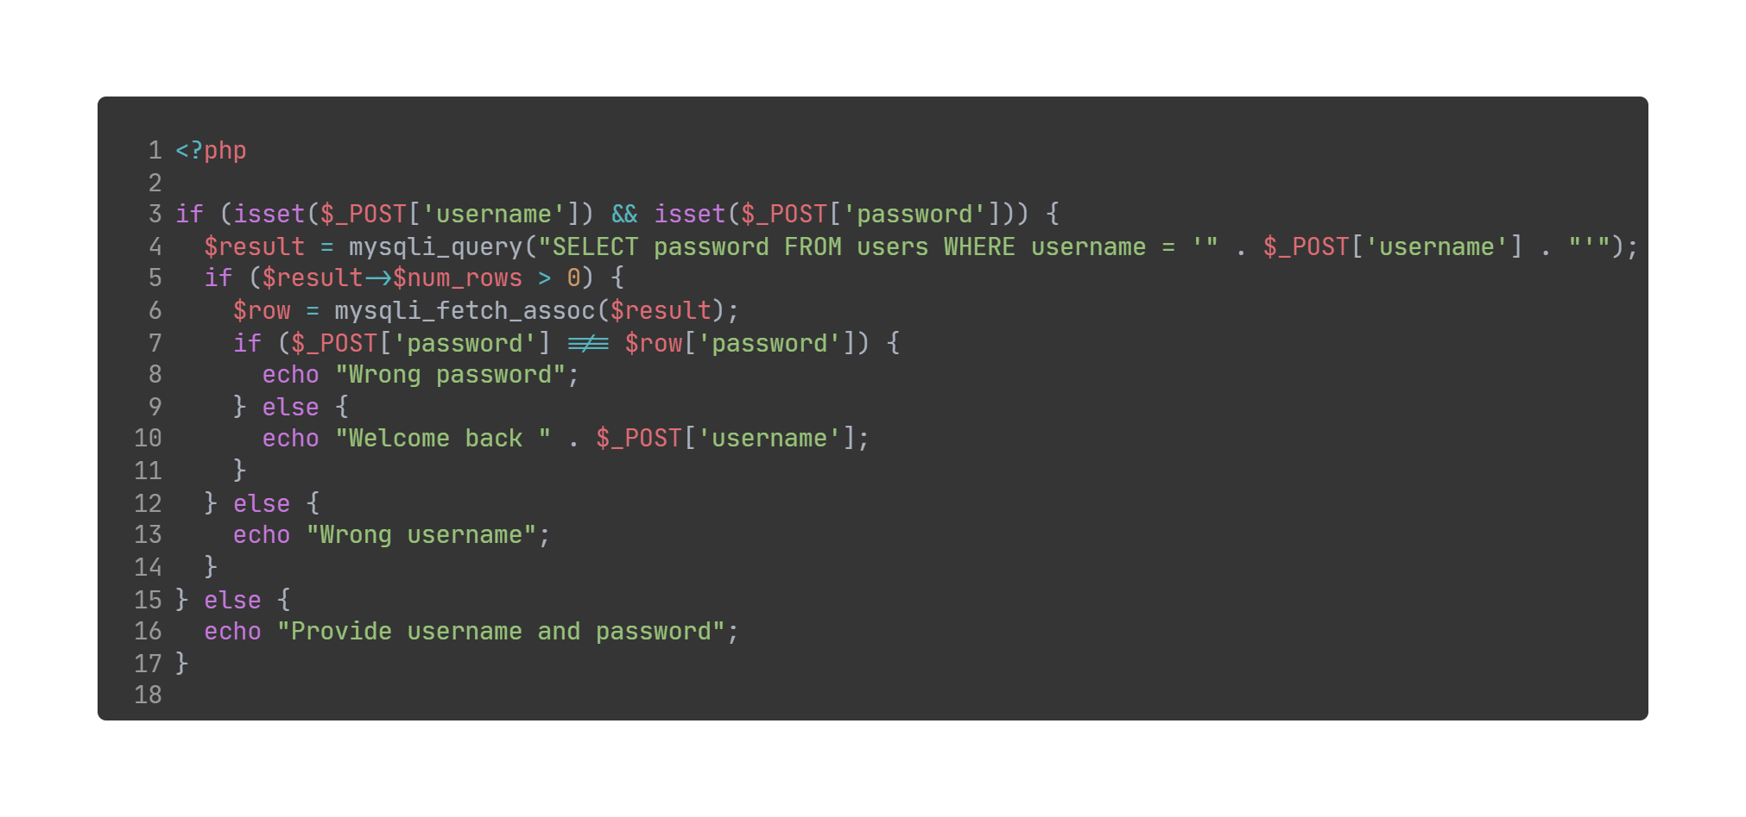
Better login
Can you leak the admin password?
Source code

Slide 18
Server side:
Logic flaws

Slide 19

Brain farts logic flaws
As human, we make mistakes. We might not be paying attention to every detail, not considering some aspects or straight up not giving a fuck.
Logic flaws can largely vary in their impact and there is no easy way to find them. Some examples:
Improper authentication
Inconsistent permissions
Wrong assumptions on user input (e.g. client side validation)
Incorrect handling of input
Missing sanity checks
…

Slide 20
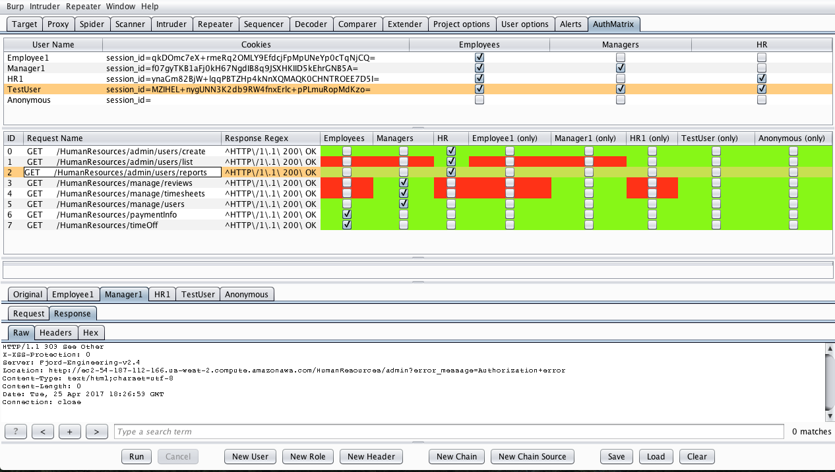
Access Control issues
Access Control issues arise when authentication isn’t enforced properly or isn’t enforced everywhere.
The easiest one is endpoints which are not authenticated at all, but in reality should be. Those endpoints may be hard to find if they are not present in the user interface or not referenced in any script.
More complex issues may allow bypassing authentication checks by changing some headers or exploiting a path normalization issue.
AuthMatrix

Slide 21
Insecure Direct Object Reference
IDOR, for short, is caused by using direct object references (database IDs, etc) given by the user without the required sanity checks on that object.
An attacker may be able to change those references knowing that they map directly to the database and perform operations without the necessary permission or in ways that shouldn’t be possible.
This is more difficult if references outside the program application are random tokens that do not map directly and mostly are invalid.
For example, an attacker might guess that user ID 1 is associated with the admin account and perform malicious actions on it with another vulnerability, but if all references are 32 characters hexadecimal tokens there is no way one could guess which corresponds to the admin.
Direct object references also usually allow enumeration of database entries by checking if an error is returned when providing a particular ID.

Slide 22
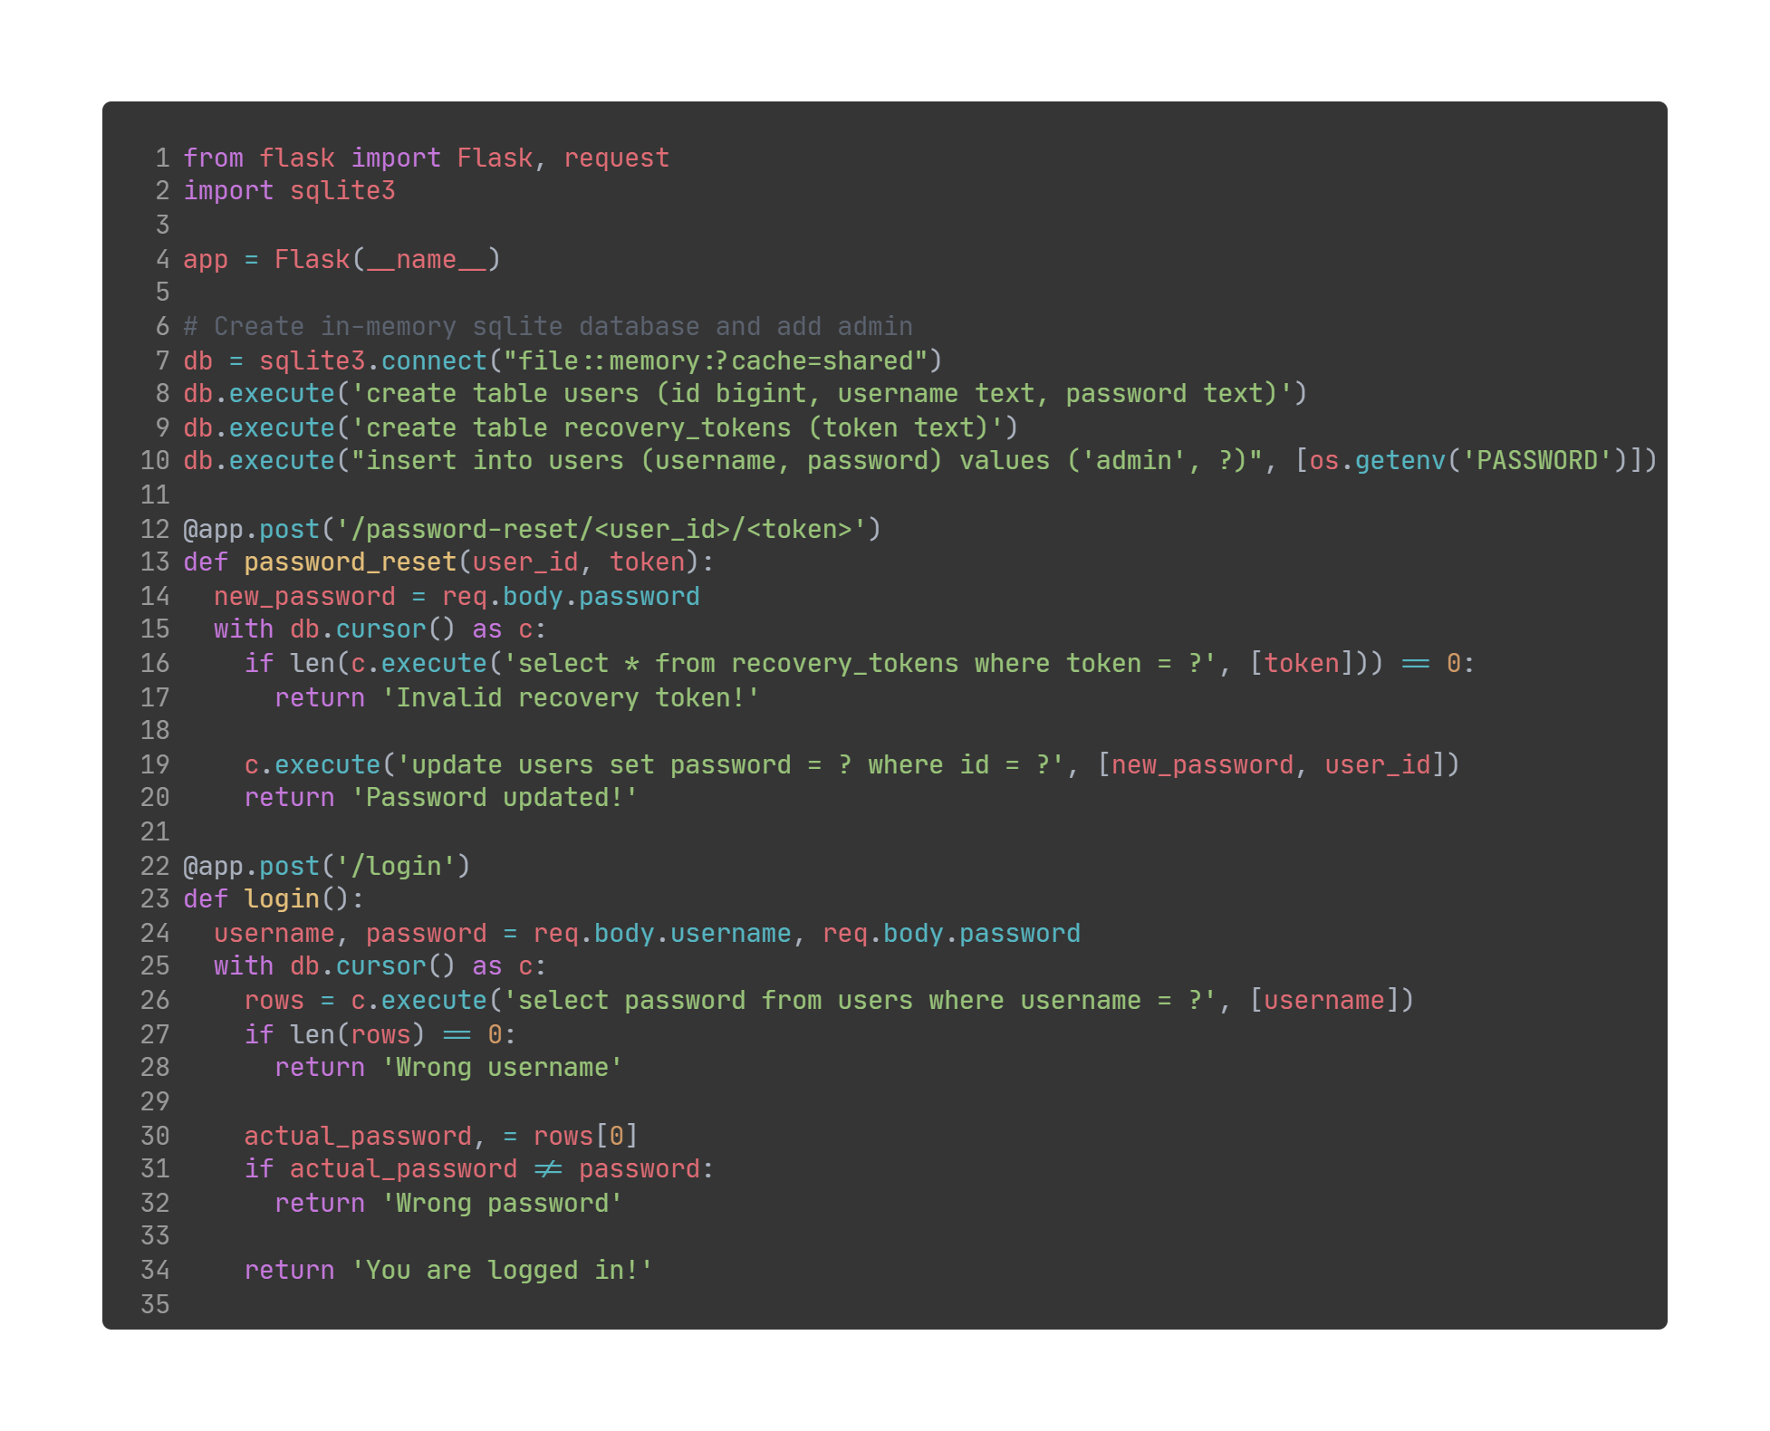
Password reset
Can you reset the admin password?
Source code

Slide 23


Incorrect input handling
By now, we have determined that all user input should be treated as malicious. It is also important to note that the user input might not come from the web page you designed for them.
APIs might be accessed freely without using web forms or other things normal users would use. Take for example the form validation provided by HTML tags which may seem ok, but it really isn’t. ANY form of client side validation is useless.
Always check what happens by submitting invalid input like empty strings, negative numbers, duplicate fields, arrays in place of structs and everything you can think of.

Slide 24
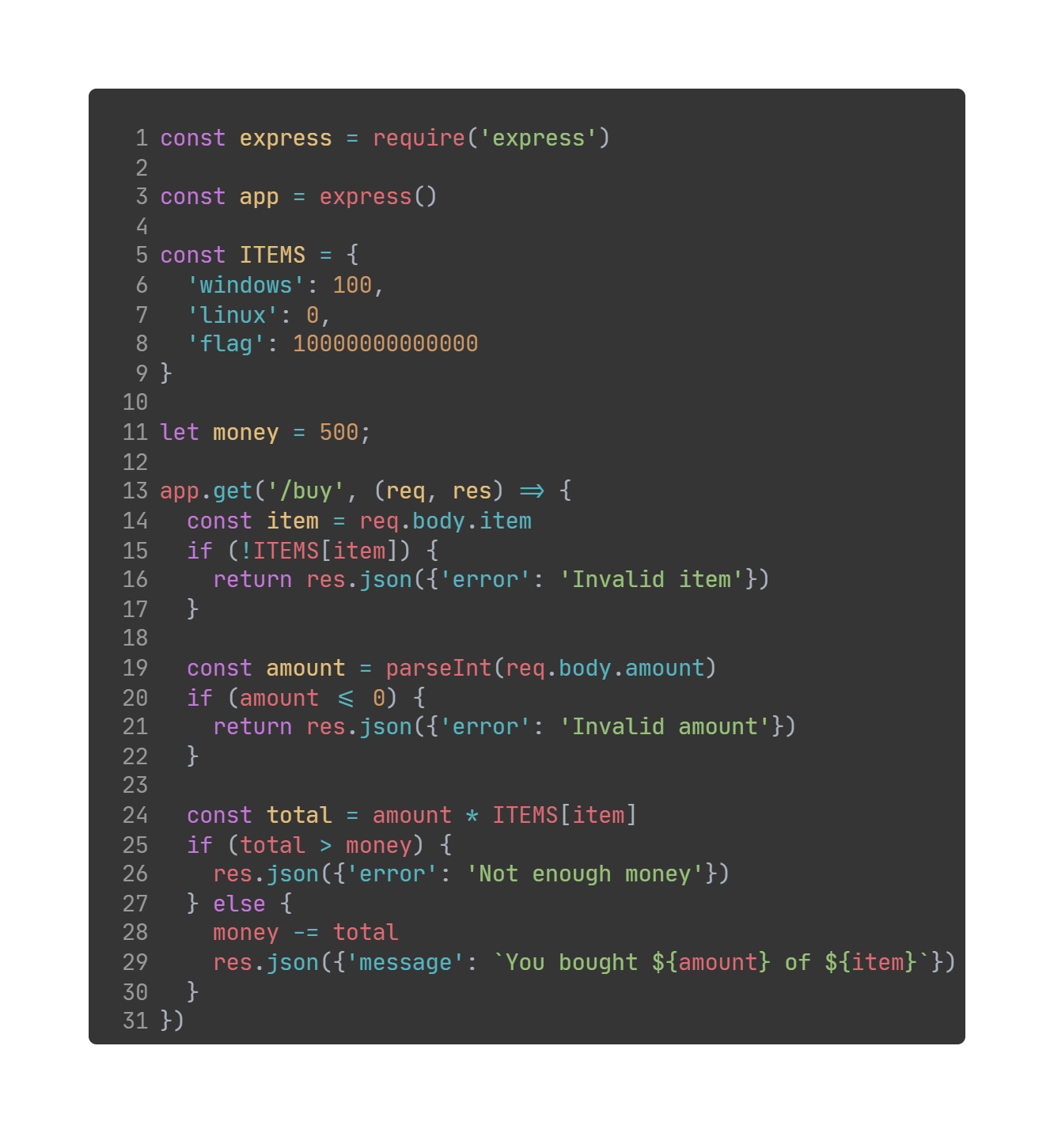
Get me some flags
Source code

